Slide 1
Introduction to Data Structures
Instructor: Maninder Kaur Tatla
Email: maninder.kaur2@sheridancollege.ca
Course: PROG20799

Slide 2
INTRODUCTION
It is important to understand the concept of Information and how it is organized or how it can be utilized.
What is Information?
If we arrange some data in an appropriate sequence, then it forms a Structure and gives us a meaning. This meaning is called Information
The basic unit of Information in Computer Science is a bit, Binary Digit
So, we found two things in Information:
One is Data and the other is Structure .

Slide 3
Data Structures
Data structure is a particular way of storing and organizing data in a computer so that it can be used efficiently.
The way in which the data is organized affects the performance of a program for different tasks.
Computer programmers decide which data structures to use based on:
the nature of the data and
the processes that need to be performed on that data.

Slide 4
Types of Data Structures
Linear:
In linear data structures, values are arranged in linear fashion.
Arrays, linked lists, stacks and queues are examples of linear data structures in which values are stored in a sequence.
Non-Linear:
The data values in this structure are not arranged in order or which are not in sequence
Tree, graph, table and sets are examples of non-linear data structures.

Slide 5
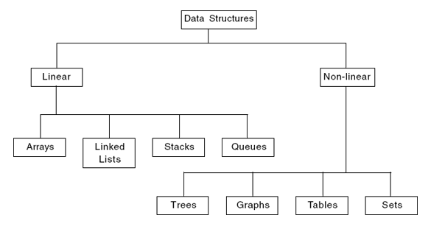
Types of Data Structures

Slide 6
Arrays
Array means collection.
An array is used to store elements of the same type.
It stores data elements in contiguous memory locations.
Array is a linear and homogenous data structure.
Homogenous means that the same types of elements are stored in it.

Slide 7
What is an Array?
“A linear array is a collection of related data items with similar data type and having a common name”.
This means that array can store either all integers, all floating points, all characters or any other complex data type, but all of the same data type.
Each element of an array is referenced by a subscripted variable called Index.

Slide 8
Types of Array
One-dimensional Array:
If single subscript is required to reference an element, then the array is known as one-dimensional array.
One-dimensional arrays are also known as linear arrays.
Two-dimensional Array:
If two subscripts are required to reference an element, then the array is known as two-dimensional array.
Multi-dimensional Array:
The arrays whose elements are referenced by two or more subscripts are called multidimensional arrays.

Slide 9
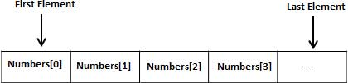
One-Dimensional Array
A specific element in an array is accessed by an index.
All arrays consist of contiguous memory locations.
The lowest address corresponds to the first element and the highest address to the last element.
In C, C++ and Java, if array size is n, then the index set consists of 0, 1, 2, 3,……, n-1.
The elements of an array A are denoted by bracket notation like A[0], A[1], A[2], A[3], A[4],……, A[N-1].

Slide 10
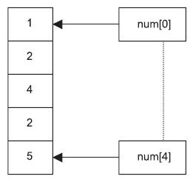
Arrays

Slide 11
Introduction
A linked list is a linear collection of data elements, called nodes, where the linear order is given by means of pointers.
Each node is divided into two parts:
The first part contains the information (Info) of the element, and
The second part, called the link field or next pointer field, contains the address of the next node in the list.
The pointer of the last node contains a special value, called the null pointer.
A special pointer variable – called START contains the address of the first node.
A special case is the list that has no nodes, such a list is called the null list or empty list and is denoted by the null pointer in the variable START.
Start
Node 1
Node 2
Node 3
Info
Link
Info
Link
Info
Linked list with 3 nodes

Slide 12
Advantages of Linked Lists
The items do not have to be stored in consecutive memory locations: the successor can be anywhere physically.
So, can be inserted and deleted items without shifting data.
Can increase the size of the data structure easily.
Linked lists can grow dynamically (i.e. at run time):
The amount of memory space allocated can grow and shrink as needed.
Insertion and deletion of nodes is quicker with linked lists.

Slide 13
Types of Linked Lists
Singly Linked List (One-Way Linked List):
Begins with a pointer to the first node
Terminates with a null pointer
Only traversed in one direction
Circular, Singly Linked:
Pointer in the last node points back to the first node
Doubly Linked List (Two-Way Linked List):
Two “start pointers” – first element and last element
Each node has a forward pointer and a backward pointer
Allows traversals both forwards and backwards
Circular, Doubly Linked List:
Forward pointer of the last node points to the first node and backward pointer of the first node points to the last node

Slide 14
Stacks
A stack is an arranged collection of elements into which
new elements can be inserted
or from which existing elements can be deleted at one end.
Stack is a set of elements in a last-in-first-out (LIFO) technique.
The last item pushed onto the stack is always the first to be removed from the stack.
The insertion of element onto the stack is called as push and deletion operation is called pop.
The end of the stack from where the insertion or deletion operation is carried out is called top.

Slide 15
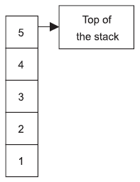
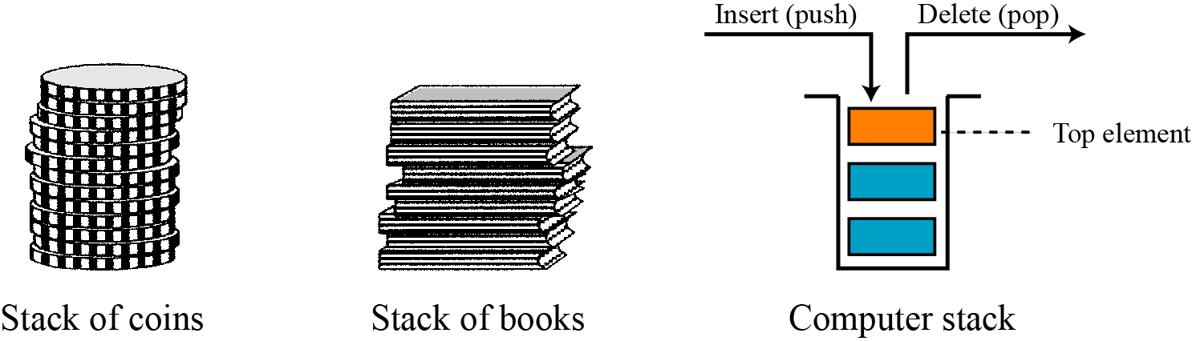
Stacks

Slide 16
Queues
Queue is a collection of elements in which
elements are inserted at one end called rear end
and elements are deleted at other end called front end.
The first entry in a queue to which the service is offered is to the element that is on front.
After servicing, it is removed from the queue.
The information is manipulated in the same sequence as it was collected.
Queue follows the rule first-in-first-out (FIFO).

Slide 17
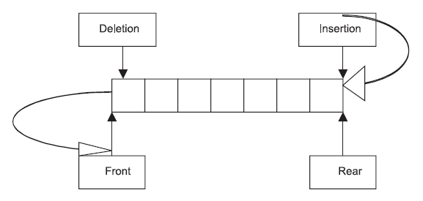
Queues

Slide 18
Trees
Data frequently contains a hierarchical relationship between various elements.
The data structure which reflects this relationship is called tree.
In tree, elements are arranged in non-linear fashion.
Tree has several practical applications:
It is immensely useful in manipulating data and to protect hierarchical relationship among data.
The fundamental operations such as insertion, deletion etc. is easy and efficient in tree data structure than in linear data structures.

Slide 19
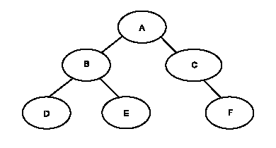
Trees

Slide 20
Graphs
Sometimes, data contains a relationship between pairs of elements which is not necessarily hierarchical in nature.
The data structure which reflects this type of relationship is called a graph.

Slide 21
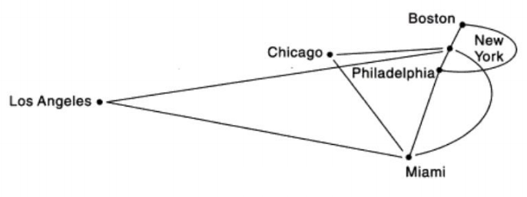
Graphs
For example:
Suppose an airline flies only between the cities connected by lines.

Slide 22
Operations on Data Structures
Traversing: Access and process every data in data structure at least once.
Searching: Search for a location of data.
Insertion: Insert item in the list of data.
Deletion: Delete item from a set of data.
Sorting: Sort data in certain order.
Merging: Merge multiple group of data.

Slide 23
Algorithm
Algorithm: a step-by-step procedure for performing a task within a finite period of time.
Algorithms often operate on a collection of data, which is stored in a structured way in the computer memory (Data Structure).
It is problem solving using logic.

Slide 24
Data Structures and Algorithms
A data structure is a systematic way of organizing and accessing data.
An algorithm is a step-by-step procedure for solving a problem in a finite amount of time.
Algorithms and Data Structures go hand-in-hand:
Certain Algorithms require certain data structures to run efficiently and vice-versa.

Slide 25

Any questions please?

